Slide 1
Dive into Self
Understanding & Facilitating Staff Wellbeing
Claire Orange
Co-director BEST Programs 4 Kids
claire.orange@bestprograms4kids.com

Slide 2
3
ways
to explore and quantify
staff wellbeing

Slide 3
The PERMA Principles
Universal principles of wellbeing
Character Strengths
- Understanding strengths you bring to a team
The Wellbeing Wheel
- work / life balance and opportunity

Slide 4
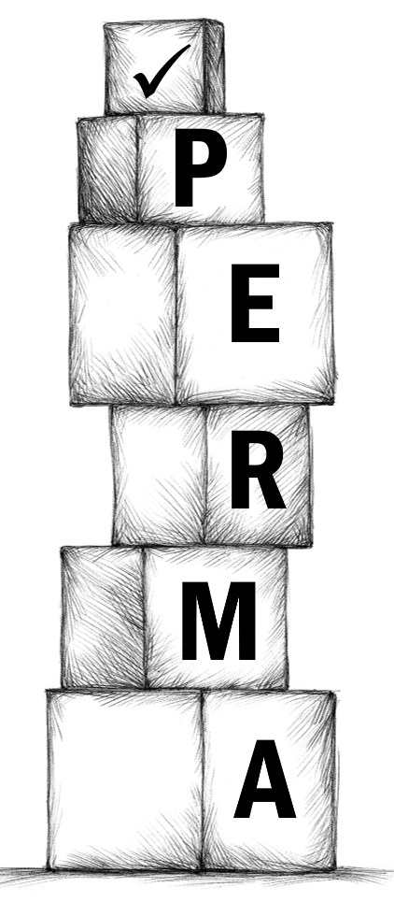
Positive emotions – feeling good, positive feelings,
Engagement – fulfilling work, interesting hobbies, flow
Relationships – social interactions, love, intimacy, emotional and physical interaction
Meaning – having a purpose, finding meaning in life
Achievement – ambition, realistic goals, important achievements, self-pride
© BEST Programs 4 Kids

Slide 5
University Penn PERMA questionnaire
https://www.authentichappiness.sas.upenn.edu/questionnaires/perma
P -Positive Emotion
E – Engagement
R – Relationships
M – Meaning
A – Achievement
© BEST Programs 4 Kids

Slide 6
VIA Institute on Character
WISDOM | TRANSCENDENCE | HUMANITY | JUSTICE | COURAGE | TEMPERANCE
Creativity | Hope | Social intelligence | Leadership | Bravery | Humility
Love of learning | Appreciation of beauty & excellence | Kindness | Fairness | Honesty | Prudence
Curiosity | Humour | Love | Teamwork | Zest | Forgiveness
Perspective | Gratitude |  |  | Perseverance | Self-regulation
Judgement | Spirituality
© BEST Programs 4 Kids

Slide 7
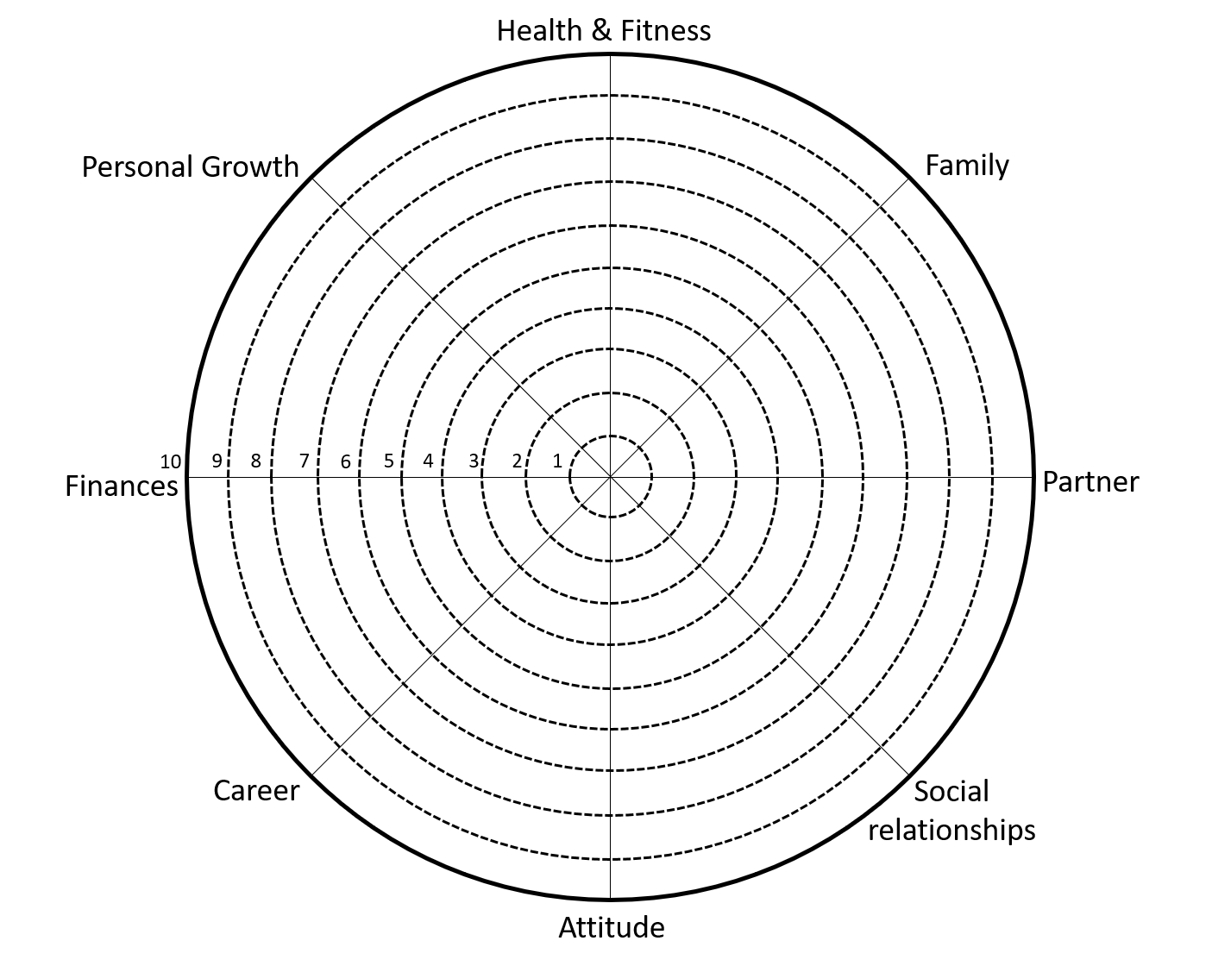
How’s your Wellbeing Wheel?
© BEST Programs 4 Kids

Slide 8
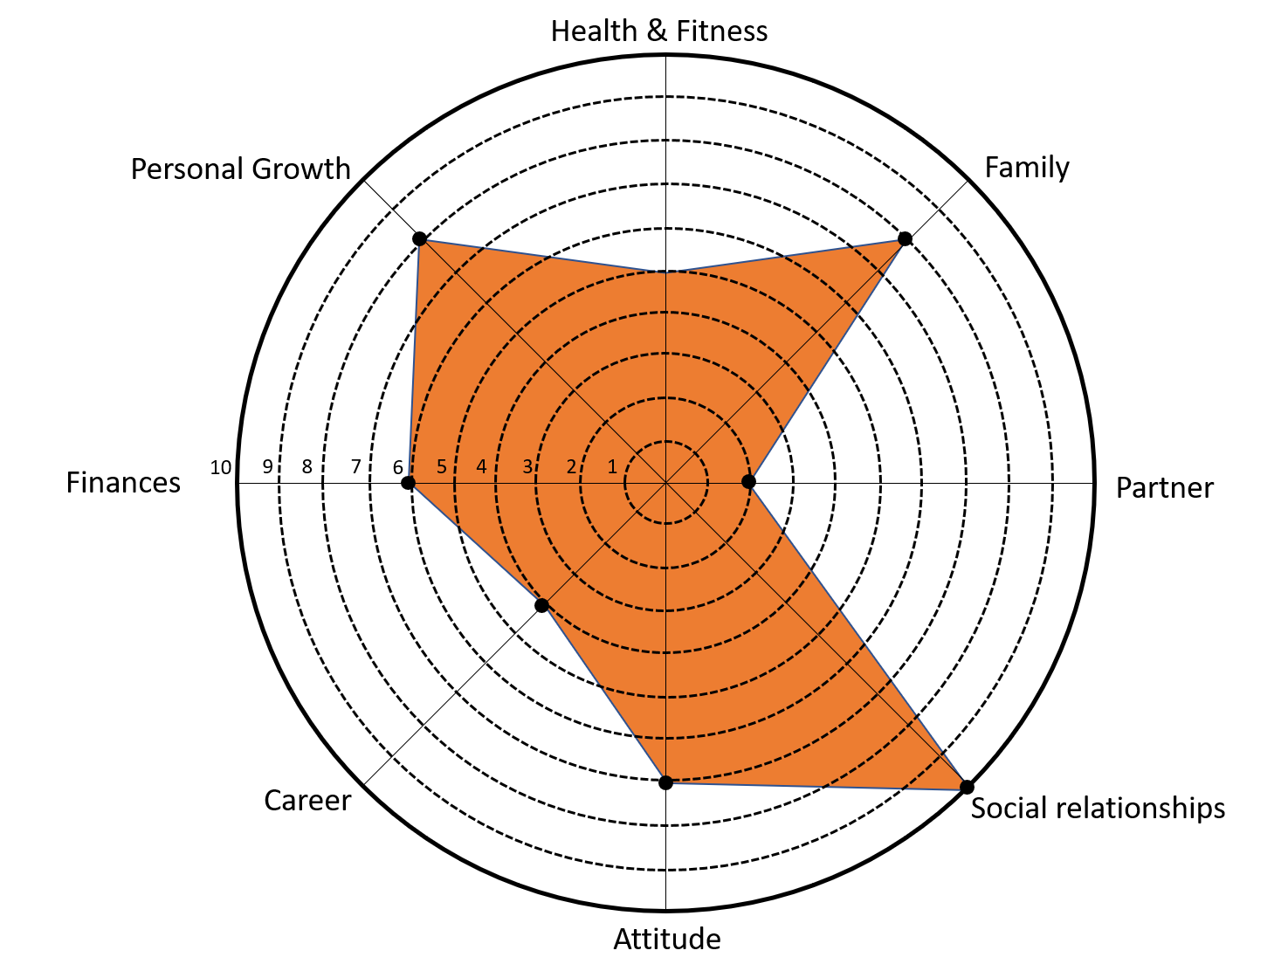
Is it balanced? Is it full?
© BEST Programs 4 Kids

Slide 9
3
ways
to develop staff self and other awareness

Slide 10
Belief systems
- Confirmation biases and ‘sure enough!’
The power of thinking
- A lifetime of shaping the inner voice
Changing thinking practices
- Daily wellbeing practices

Slide 11
Beliefs
We act in accordance with the truth as we believe it to be
Lou Tice

Slide 12
Nurture Conditioning through experiences
Perception The unique lens through which life is seen, taking into account genetic blueprint, nurture and conscious processing
Beliefs Judgements based on experiences, their perception and the associations made
Association The linking of experiences with perception
Genetic blueprint Hereditary factors
Conscious Processing Absorbing and processing of all sensory information
© BEST Programs 4 Kids

Slide 13
Are you a square watermelon?
© BEST Programs 4 Kids

Slide 14
The way to wellbeing is paved with hard questions
What is it that you believe – and enact – that’s an experiential relic?
What beliefs have you locked-on whilst locking-out other possibilities?
How do you keep yourself growing and accountable?
Who’s the truth-speaker in your life who pushes back on your beliefs and confirmation biases that limit personal growth?
Have psychological blind spots giving self-awareness of skills, talents and gifts impacted your relationships, self-confidence, self-esteem, self-worth?
© BEST Programs 4 Kids

Slide 15
The power of thinking
No pessimist ever discovered the secrets of the stars or sailed to an uncharted land or opened a new doorway.
Helen Keller

Slide 16
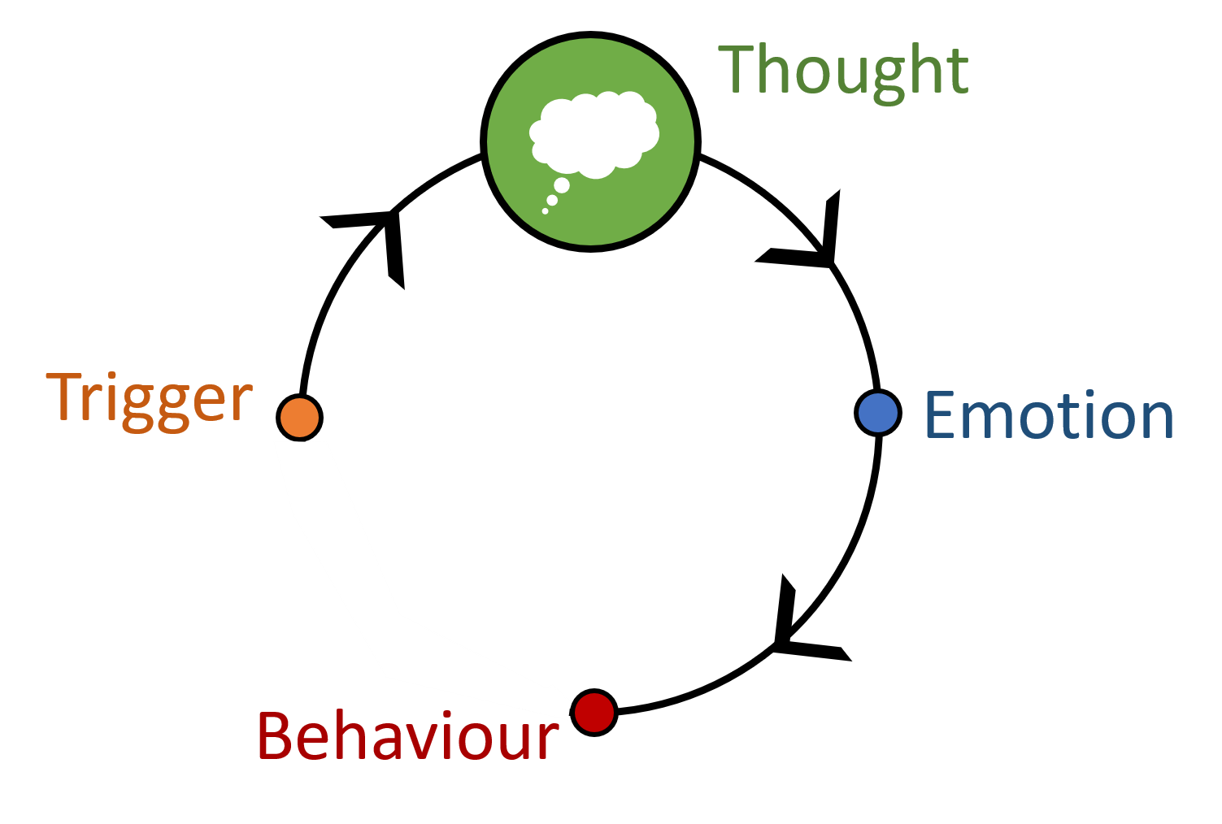
“It’s not what happens to us, but how we think about it, that matters”.
Epictetus, ancient Greek philosopher
I’m scared to death of heights
I’ve always been terrified of the dark
© BEST Programs 4 Kids

Slide 17
You’ll never make it
A lifetime of ‘Who said’s’
You’ve got this!
People with ‘great authority’ are often the ‘Who said’s’ for children and adults
Put your mind it and it’s possible
Who are the‘Who said’s’ who’ve had - or continue to have - authority over your life, thinking, success?
You’re just not getting it!
© BEST Programs 4 Kids

Slide 18
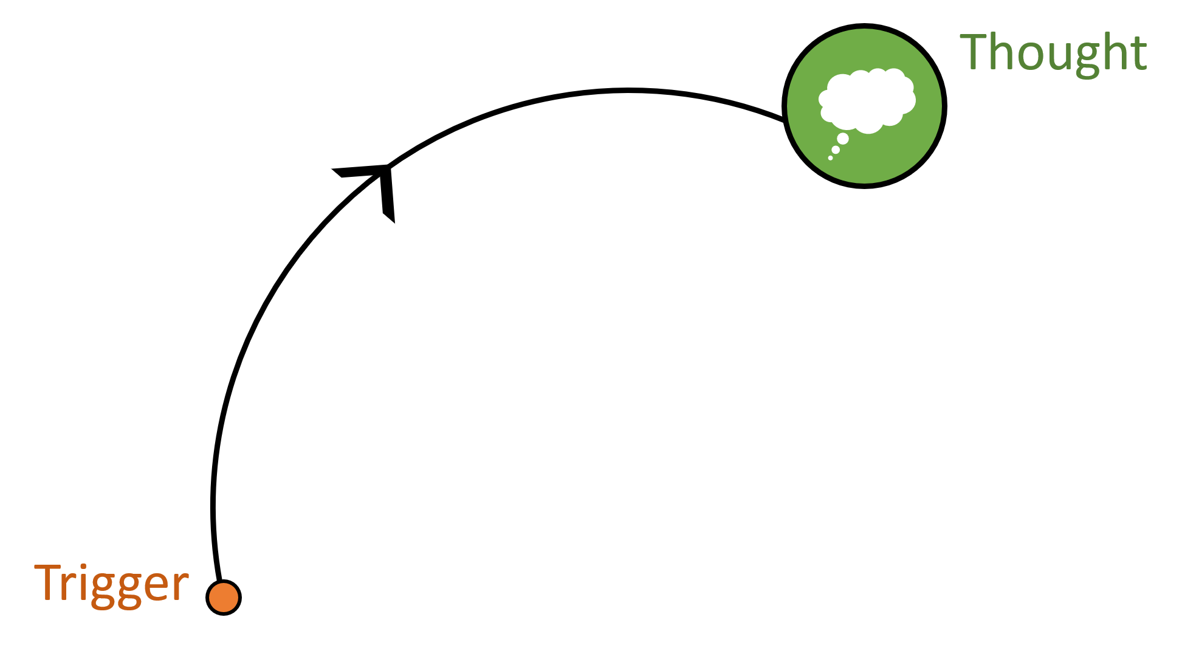
Thinking ruts
Automatic
Immediate
Self-fulfilling
What are the thinking ruts that you’ve travelled along so often that they’re etched into your brain?
Are there predictions of ‘too hard’ or ‘too much’ that shape outcome before effort?
‘Misery loves company’ with naysayers often finding company to support their thinking.
© BEST Programs 4 Kids

Slide 19
What are your ‘thinking ruts?
Thinking styles become habituated. What are yours? Rate yourself.
Black and white thinking: characterised by words such as, ‘should’, ‘must’, ‘have to’, ‘can’t,’’ always’ and ‘never’, e.g., ‘I’m always the one to stay after school to pack away’.
Catastrophising: predicting that an event or circumstance will be the worst possible – and therefore, that the outcome will be catastrophic. ‘Presenting to the team will be a nightmare. I’ll look nervous, stumble on my words, forget what to say and they’ll think I’m an idiot’.
Low frustration-tolerance thinking: characterised by unhelpful thoughts such as, ‘It’s never fair’; ‘I can’t deal with this’! or, ‘Nobody in the world could deal with this’!
Self-condemning thinking – characterised by thoughts such as, ‘I’m useless’ or, ‘I’m hopeless at this’ or, ‘I’m such a failure’. This can also be used in referencing others.

Slide 20
3
ways
to amplify staff
wellbeing contextually

Slide 21
Staffroom fun – growing together
- Team-building fun
Between-staff - care-building
- Planned acts of kindness
Staff events – celebrating together
- Whole a staff morning tea celebrations

Slide 22
A year immersed in wellbeing
 | TERM 1 | TERM 2 | TERM 3 | TERM 4
Staffroom | Fun facts | Positive affirmations | Magnificent Mindful Moments | Gratitude challenge
Between-staff | Warm fuzzy: “I appreciate you…” | Pigeon-hole post-its | “I’ll make your tea” pay-it-forward challenge | Secret Santa
Event | Only ‘healthy’ morning tea | Only ‘P’ morning tea | Only ‘leadership team’ morning tea | Only ‘red’ morning tea
© BEST Programs 4 Kids
Notes:
Provide butchers paper and plan 4 terms of wellbeing under agreed headings

Slide 23
Raising staff resonance
 | Whole staff | Between-staff | Staff events
TERM 1 | Fun Facts | Gratitude & appreciation | Only ‘healthy’ morning tea
TERM 2 | Positive Affirmations | Pigeon hole post-its | Only ‘P’ morning tea
TERM 3 | Magnificent Mindful Moments | Pay it forward challenge | Only ‘leadership’ morning tea
TERM 4 | Gratitude Challenge | Secret Santa | Only ‘red’ morning tea
© BEST Programs 4 Kids
Notes:
Provide butchers paper and plan 4 terms of wellbeing under agreed headings

Slide 24
The CARE Factor Online Training offers a deep dive into the fascinating science of educator wellbeing. Practical and meaningful personal development raising staff wellbeing through:
12-month access – on-demand learning
9 self-paced units
Video training in each Module (6 hours)
Downloadable Reflection Guide in each Module
Watch and complete in your own time
PL Certificate available on completion
Individual or whole-of-school access
bestprograms4kids.com/shop/the-care-factor/
© BEST Programs 4 Kids
Notes:
Provide butchers paper and plan 4 terms of wellbeing under agreed headings

Slide 25
Thank you
Join us on Facebook
facebook.com/bestprograms4kids
Send an email
claire.orange@bestprograms4kids.com
Visit the website bestprograms4kids.com

